Slide 1


Slide 2

What is a UML sequence diagram?
  Introduce commonly used elements of UML sequence diagrams
  How to use the elements to create sequence diagram
  When should I create it

Slide 3

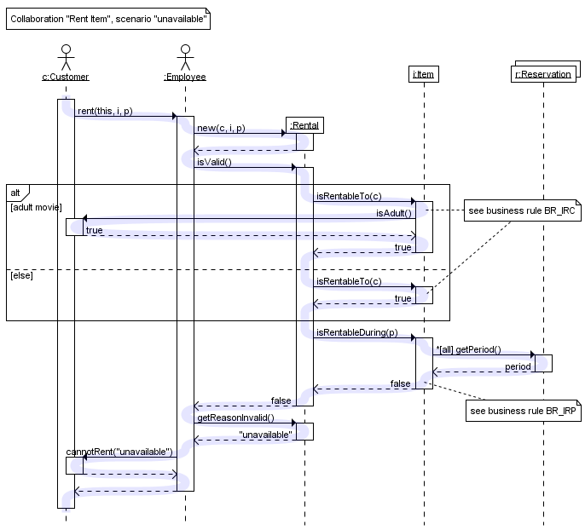
UML sequence diagrams are used to show how objects interact in a given situation. An important characteristic of a sequence diagram is that time passes from top to bottom : the interaction starts near the top of the diagram and ends at the bottom

Slide 4


A popular use for them is to document the dynamics in an object-oriented system. For each key collaboration, diagrams are created that show how objects interact in various representative scenarios for that collaboration.
From previous illustration, a blue highlight was added to represent the flow of control. Note that this highlight is not part of the diagram itself.
As with all UML diagrams, comments are shown in a rectangle with a folded-over corner
To relate the comment to whatever
diagram elements it is about, connect
them with dashed lines.

Slide 5


Objects as well as classes can be targets on a sequence diagram, which means that messages can be sent to them.
A target is displayed as a rectangle with some text in it.
Below the target, its lifeline extends for as long as the target exists.
The lifeline is displayed as a vertical dashed line.

Slide 6
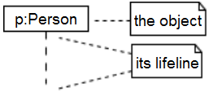
Where 'name' is the name of the object in the context of the diagram
'Type' indicates the type of which the object is an instance.
Note that the object doesn't have to be a direct instance of Type, a type of which it is an indirect instance is possible too. So 'Type' can be an abstract type as well.
An object named p of class Person
p - name
Person - type

Slide 7
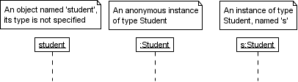
Both name and type are optional, but at least one of them should be present.

Slide 8

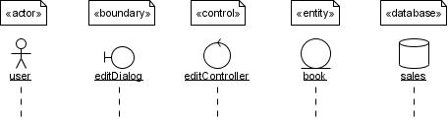
As with any UML-element, you can add a stereotype to a target. Some often used stereotypes for objects are «actor», «boundary», «control», «entity» and «database». They can be displayed with icons as well :
Try to avoid long but non-descriptive names when you're also specifying the type of the object (e.g. don't use 'aStudent' for an instance of type Student). A shorter name carries the same amount of information and doesn't clutter the diagram (e.g. use 's' instead).

Slide 9


When you want to show how a client interacts with the elements of a collection, you can use a multiobject. Its basic notation is:
Again, a name and/or type can be specified. Note however that the 'Type' part designates the type of the elements and not the type of the collection itself.

Slide 10


The basic notation for a class is:
Only class messages (e.g. shared or static methods in some programming languages) can be sent to a class. Note that the text of a class is not underlined, which is how you can distinguish it from an object.

Slide 11

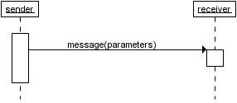
When a target sends a message to another target, it is shown as an arrow between their lifelines. The arrow originates at the sender and ends at the receiver. Near the arrow, the name and parameters of the message are shown.

Slide 12

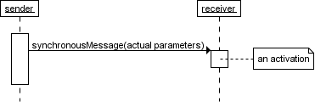
A synchronous message is used when the sender waits until the receiver has finished processing the message, only then does the caller continue (i.e. a blocking call). Most method calls in object-oriented programming languages are synchronous. A closed and filled arrowhead signifies that the message is sent synchronously.
The white rectangles on a lifeline are called activations and indicate that an object is responding to a message. It starts when the message is received and ends when the object is done handling the message.

Slide 13
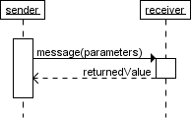
When a messages are used to represent method calls, each activation corresponds to the period during which an activation record for its call is present on the call stack.
If you want to show that the receiver has finished processing the message and returns control to the sender, draw a dashed arrow from receiver to sender. Optionally, a value that the receiver returns to the sender can be placed near the return arrow.
If you want your diagrams to be easy to read, only show the return arrow if a value is returned. Otherwise, hide it.

Slide 14

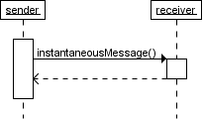
Messages are often considered to be instantaneous, i.e. the time it takes to arrive at the receiver is negligible. For example, an in-process method call. Such messages are drawn as a horizontal arrow.

Slide 15
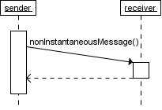
Sometimes however, it takes a considerable amount of time to reach the receiver (relatively speaking of course) . For example, a message across a network. Such a non-instantaneous message is drawn as a slanted arrow.
You should only use a slanted arrow if you really want to emphasize that a message travels over a relatively slow communication channel (and perhaps want to make a statement about the possible delay). Otherwise, stick with a horizontal arrow.

Slide 16

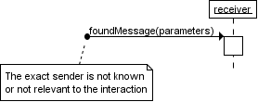
A found message is a message of which the caller is not shown. Depending on the context, this could mean that either the sender is not known, or that it is not important who the sender was. The arrow of a found message originates from a filled circle.

Slide 17

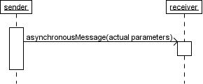
With an asynchronous message, the sender does not wait for the receiver to finish processing the message, it continues immediately. Messages sent to a receiver in another process or calls that start a new thread are examples of asynchronous messages. An open arrowhead is used to indicate that a message is sent asynchrously.
Note: once the message is received, both sender and receiver are working simultaneously. However, showing two simultaneous flows of control on one diagram is difficult. Usually authors only show one of them, or show one after the other.

Slide 18

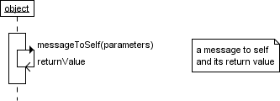
A message that an object sends itself can be shown as follows :
Keep in mind that the purpose of a sequence diagram is to show the interaction between objects, so think twice about every self message you put on a diagram.

Slide 19
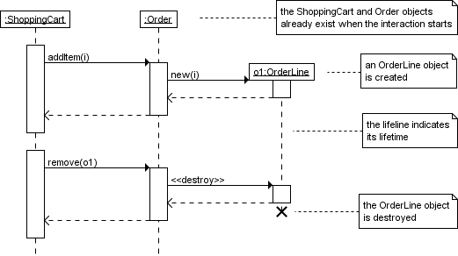
Targets that exist at the start of an interaction are placed at the top of the diagram. Any targets that are created during the interaction are placed further down the diagram, at their time of creation.
A target's lifeline extends as long as the target exists. If the target is destroyed during the interaction, the lifeline ends at that point in time with a big cross.

Slide 20

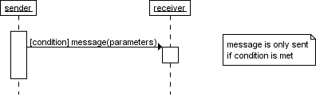
A message can include a guard, which signifies that the message is only sent if a certain condition is met. The guard is simply that condition between brackets.

Slide 21

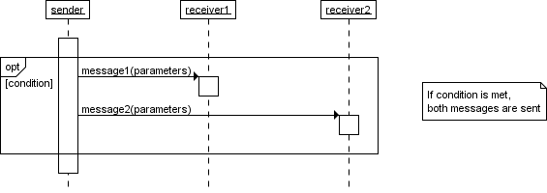
If you want to show that several messages are conditionally sent under the same guard, you'll have to use an 'opt' combined fragment. The combined fragment is shown as a large rectangle with an 'opt' operator plus a guard, and contains all the conditional messages under that guard.
A guarded message or 'opt' combined fragment is somewhat similar to the if-construct in a programming language.

Slide 22
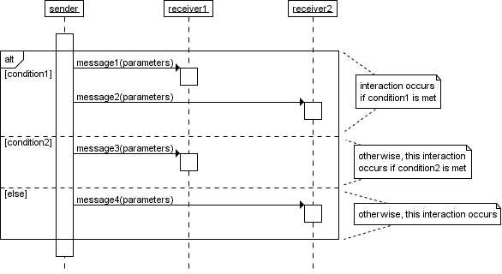
If you want to show several alternative interactions, use an 'alt' combined fragment. The combined fragment contains an operand for each alternative. Each alternative has a guard and contains the interaction that occurs when the condition for that guard is met.
At most one of the operands can occur. An 'alt' combined fragment is similar to nested if-then-else and switch/case construct

Slide 23

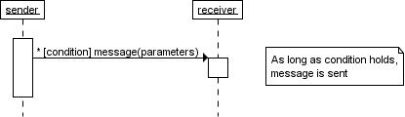
When a message is prefixed with an asterisk (the '*'-symbol), it means that the message is sent repeatedly. A guard indicates the condition that determines whether or not the message should be sent (again). As long as the condition holds, the message is repeated.
The above interaction of repeatedly sending the same message to the same object is not very useful, unless you need to document some kind of polling scenario.

Slide 24

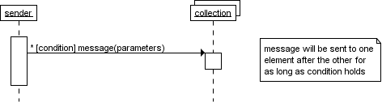
A more common use of repetition is sending the same message to different elements in a collection. In such a scenario, the receiver of the repeated message is a multiobject and the guard indicates the condition that controls the repetition.
This corresponds to an iteration over the elements in the collection, where each element receives the message. For each element, the condition is evaluated before the message is sent. Usually though, the condition is used as a filter that selects elements from the collection (e.g. 'all', 'adults', 'new customers' as filters for a collection of Person objects). Only elements selected by the filter will receive the message.

Slide 25
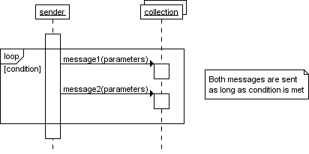
If you want to show that multiple messages are sent in the same iteration, a 'loop' combined fragment can be used. The operator of the combined fragment is 'loop' and the guard represents the condition to control the repetition.
Again, if the receiver of a repeated message is a collection, the condition is generally used to specify a filter for the elements.

Slide 26
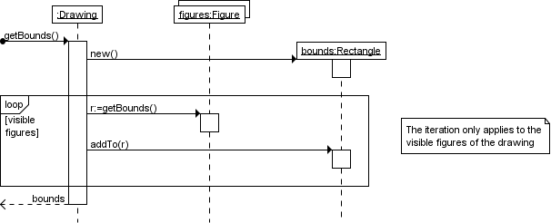
To show that the bounds of a drawing are based on those of its visible figures we could draw the following sequence diagram :

Slide 27
Several things are worth noting in the previous example
a local variable 'r' was introduced to clarify that it is the result of getBounds that is added.
naming the resulting Rectangle 'bounds' avoids the introduction of an extra local variable.
the loop condition is used as a filter on the elements of the figures collection.

Slide 28

Of all the UML diagram types, the sequence diagram type is the one where it matters most to choose the right tool for the job. The reason being that you have very little freedom when it comes to positioning elements on a sequence diagram.
You really need a tool that was designed with sequence diagrams in mind. Don't even think about using a general-purpose drawing tool, you'll waste hours connecting, resizing and laying out shapes.
Here are some sequence diagram editors:
  Trace Modeler
  Lucidchart

Slide 29

http://www.tracemodeler.com/articles/a_quick_introduction_to_uml_sequence_diagrams/
http://www.inf.ed.ac.uk/teaching/courses/seoc/2011_2012/notes/SEOC08_notes.pdf
For further reading:
http://www.visual-paradigm.com/tutorials/constructseqdiagram.jsp
http://edn.embarcadero.com/article/31863

